Slide 1
Real-time Video effect
Hongyi Sun(hs3497) Qiongxuan Tan(qt310)

Slide 2
Project Introduction.
01
Principles and Formulas.
02
CONTENTS
Conclusion and Demo
03

Slide 3
Project Introduction.
/01

Slide 4




Project Introduction
Instagram
TikTok
VSCO
Snapchat
Today, it is fashionable to post videos on social networks. And videos with some special effect are likely to draw more attention than the other. As people enjoy watching the effect while recording the video than applying afterward, real-time video effect are crucial for the need of social media.

Slide 5
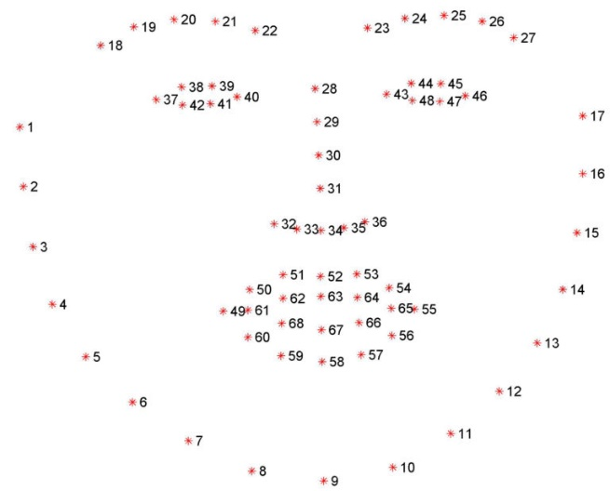
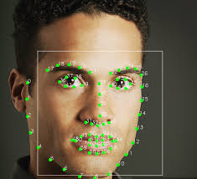
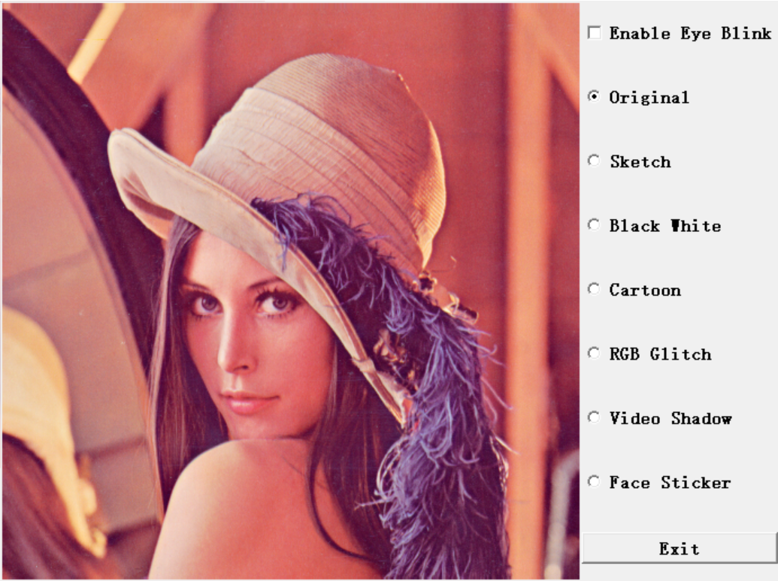
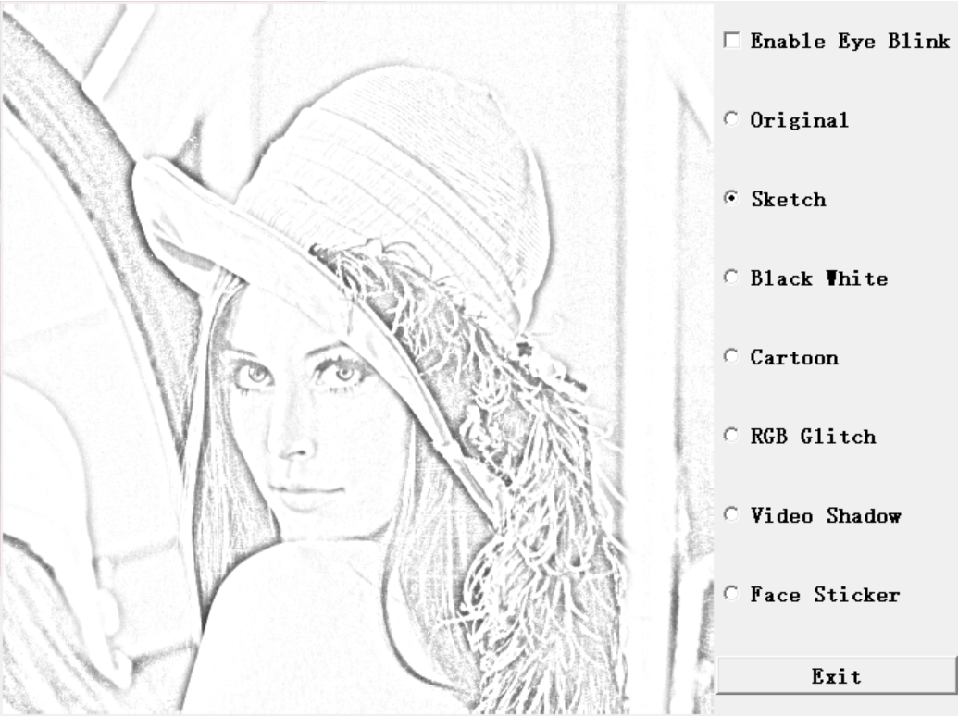
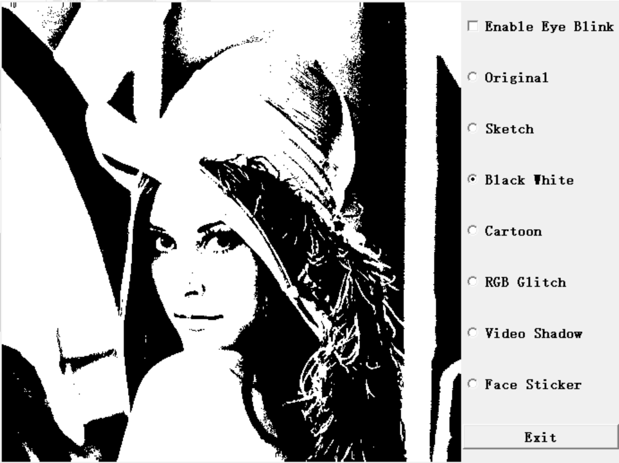
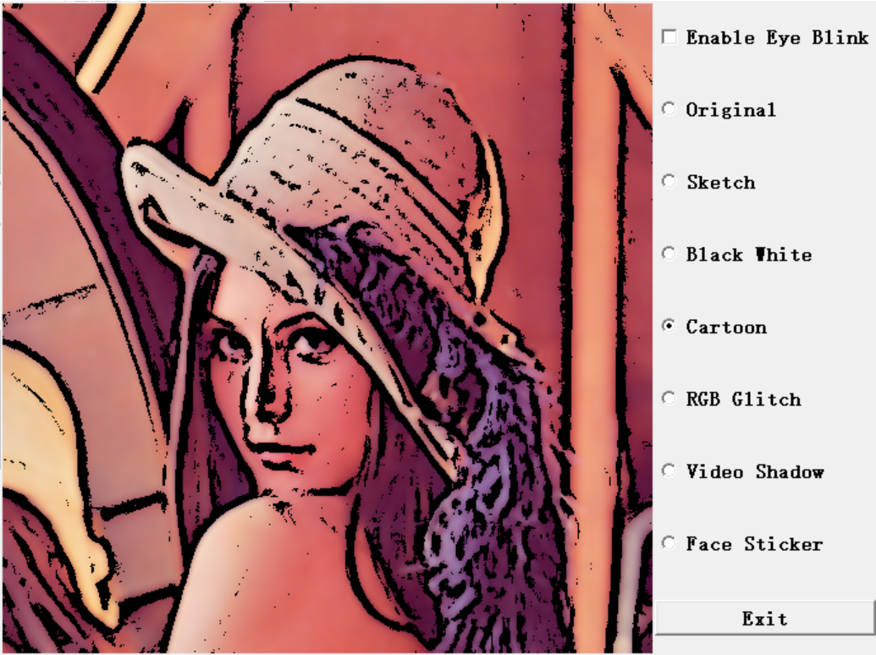
Project Introduction
In this project, we build software that can apply multi special effects on video in real time. We implement effects such as some basic style filters and animation style filters.
The basic filters includes simple black-and white filter, pencil sketch filter, RGB-Glitch filter, cartoon filter and video shadow filter. We use facial landmarks to add face sticker onto faces and control features like the mouth size on the sticker. Also, we switch filters by blinking our eyes, which will be detected due to the change of eye contour.

Slide 6
Principles and Formulas.
/02

Slide 7
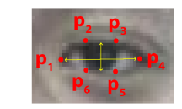
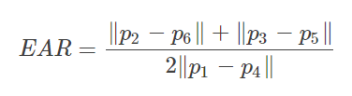
Principles and Formulas: Eye Blink Detection
eye aspect ratio (EAR)
EYE_AR_THRESH = 0.22
EYE_AR_CONSEC_FRAMES = 3
Soukupová T, Cech J. Real-time eye blink detection using facial landmarks[C]//21st Computer Vision Winter Workshop. 2016.

Slide 8
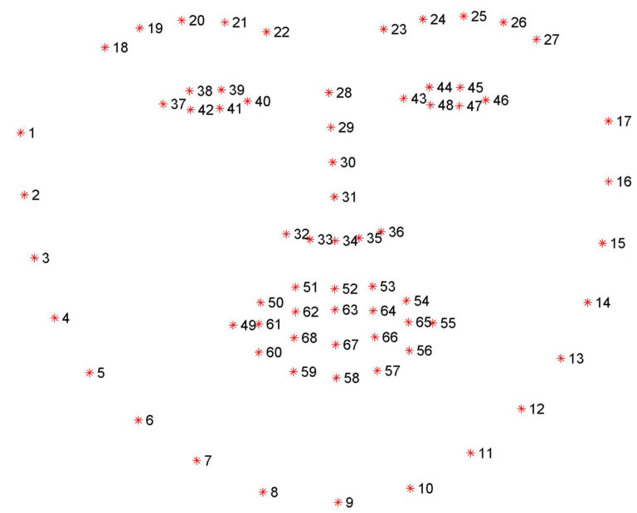

Principles and Formulas: Face Sticker
Center point of the face:
Point 30
Relative width of the face sticker:
point 1, point 17

Slide 9
Principles and Formulas: Face Sticker
α
Center point of the face:
Point 30
Relative width of the face sticker:
point 1, point 17
Angle of the face sticker:
point 37, point 46
α

Slide 10


Principles and Formulas: Mouth Sticker
Relative width of the mouth:
point 49, point 55
Relative height of the mouth:
point 63, point 67

Slide 11
Conclusion and Demo.
/03

Slide 12
Thanks.

